Slide 1
Mid Year Review Step – Performance Review
Mid Year Review is a checkpoint between you and your manager to discuss progress, update priorities, add new objectives and identify development areas for the rest of the year.
This takes place during September each year
You are automatically notified via workflow
More information/training will be available to you at Mid Year review Step

Slide 2
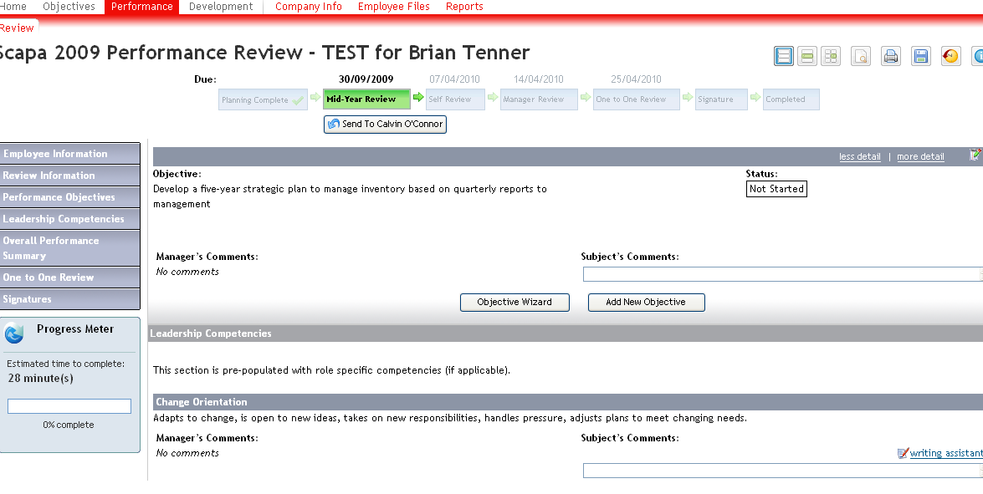
Mid Year Review Step - Performance Review
Click here to send to manager and initiate workflow
Click here to update status of objectives
Make comments and give examples where possible. No action is required at the Planning step

